Slide 1



Crop & Fertilizer Recommendation System
using Machine Learning

Slide 2

Learning Objectives
Understand Agricultural Data
Data Visualization & Insights
Apply Data Preprocessing Techniques
Develop Machine Learning Models
GOAL

Slide 3
Tools and Technology used
NumPy – Used for numerical computations, handling arrays, and performing mathematical operations efficiently.
Pandas – A powerful library for data manipulation and analysis, providing data structures like DataFrames and Series.
Matplotlib – A plotting library used to create static, animated, and interactive visualizations.
Seaborn – Built on top of Matplotlib, it simplifies statistical data visualization with beautiful, informative charts.
Scikit-Learn – A machine learning library that provides tools for classification, regression, clustering, dimensionality reduction, and model evaluation.

Slide 4
Methadology:
Data Collection and Preparation: We gather soil, weather, and crop datasets from reliable sources. This includes soil nutrient levels, pH, weather parameters (temperature, rainfall), and crop-specific information. We then clean, analyze, and visualize this data to understand patterns and relationships.
Feature Engineering and Selection: We extract and create meaningful features from the raw data to improve model accuracy. This may involve deriving new variables or transforming existing ones. We then select the most relevant features for our models.
Model Development and Training: We train machine learning models, such as regression or classification models, using the prepared data. These models are designed to predict optimal crop choices and fertilizer recommendations.

Slide 5
Methadology:
Model Evaluation and Refinement: We assess model performance using appropriate metrics like Accuracy , Precision , Classification Report and refine the models through techniques like hyperparameter tuning and exploring different algorithms.
Deployment and Monitoring: We deploy the trained model in a user-friendly system, allowing farmers to input their data and receive recommendations. We continuously monitor system performance and incorporate feedback for ongoing improvement.

Slide 6
Problem Statement:
Farmers frequently face challenges in crop and fertilizer selection due to the absence of scientific soil and environmental analysis. Traditional farming methods often result in suboptimal yields, soil depletion, and inefficient fertilizer use, negatively affecting both productivity and long-term sustainability.
A Machine Learning-based Crop & Fertilizer Recommendation System is proposed to address these issues by analyzing soil nutrients, pH, weather patterns, and crop requirements. This data-driven approach aims to improve agricultural productivity, optimize resource allocation, and promote sustainable farming through intelligent guidance.

Slide 7
Solution:
Predictive Modeling for Optimized Recommendations: We will develop machine learning models trained on historical data encompassing soil properties (nutrient levels, pH), weather data (temperature, rainfall, humidity), and crop yields. These models will learn the complex relationships between these factors and predict optimal crop choices and fertilizer applications for specific locations and conditions.
Continuous Learning and Refinement: The system will be designed for continuous learning and improvement. As farmers use the recommendations and provide feedback on crop yields and soil health, this new data will be fed back into the models. This feedback loop will allow the models to adapt and refine their predictions over time, becoming more accurate and effective.

Slide 8
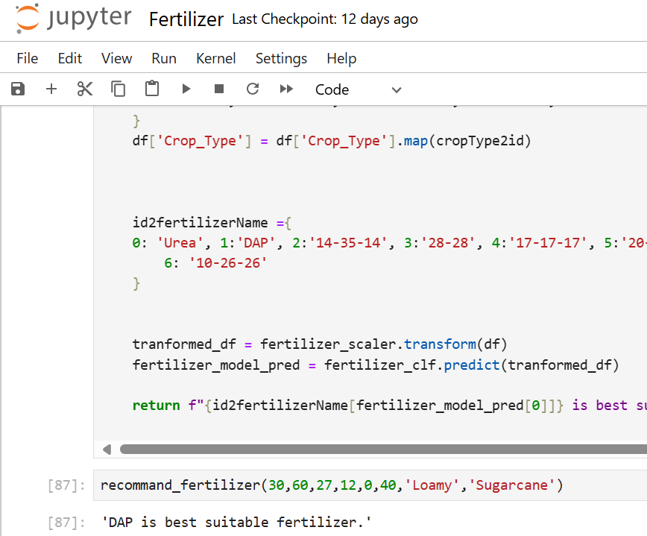
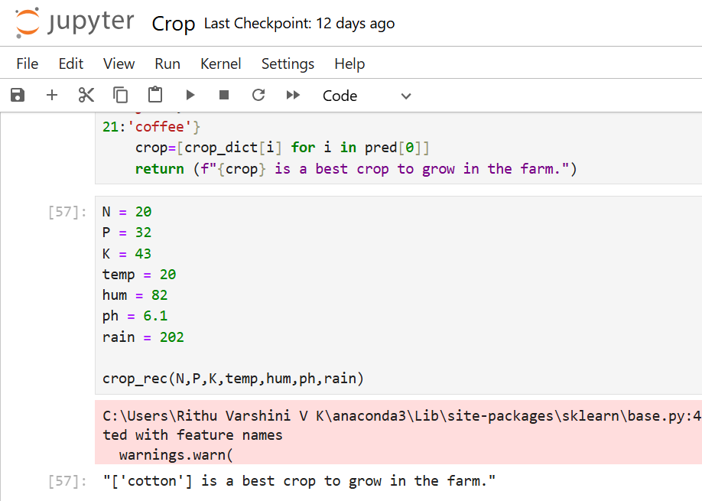
Screenshot of Output:
Crop Recommendation system output
Fertilizer Recommendation system output

Slide 9
Conclusion:
This structured methodology, encompassing comprehensive data collection and preparation, insightful feature engineering, robust model development and training, rigorous evaluation and refinement, and continuous monitoring, will result in a reliable and effective machine learning system for optimized crop and fertilizer recommendations, empowering farmers with data-driven insights for increased productivity and sustainable agriculture. The system will leverage soil data (nutrient levels, pH, etc.), weather data (temperature, rainfall, humidity), and crop-specific information (yields, nutrient requirements) to provide personalized recommendations. By continuously learning and adapting to new data and feedback, the system will ensure long-term accuracy and relevance, promoting both economic benefits for farmers and environmentally sound practices.

